Slide 1
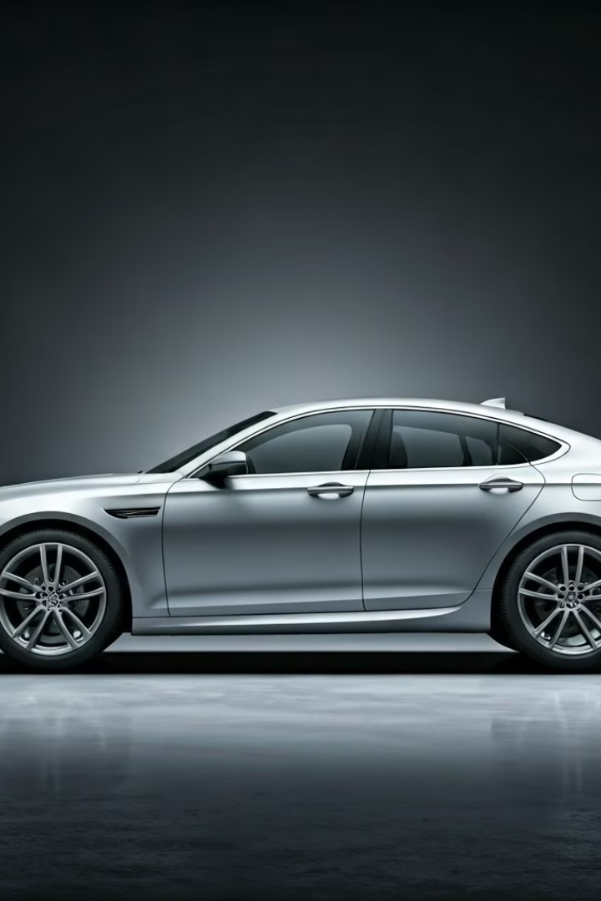
Cars Classification Using Deep Learning
This presentation explores car classification using a Convolutional Neural Network (CNN). We'll cover the dataset, model architecture, training process, and results.
Karieem Alsayed
Osama Ahmed
Mohamed Hossam
Islam Mohamed
Yousef Ahmed
Shadia Elsayed

Slide 2
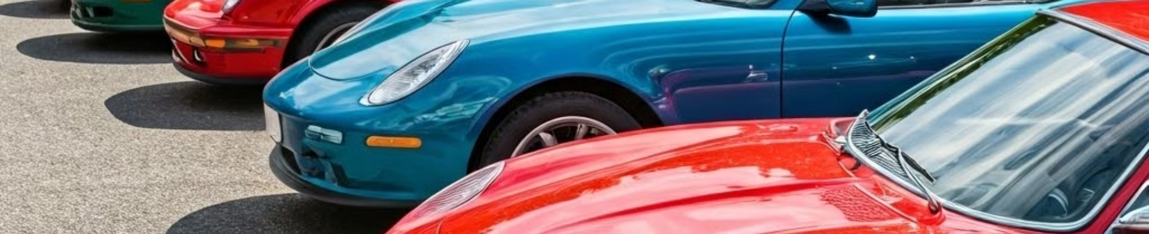
Introduction
1
Motivation
2
Challenge
3
Approach
Automated car classification has applications in various fields.
Building accurate models requires careful data preparation and model selection.
Deep learning offers promising results in image classification tasks.

Slide 3
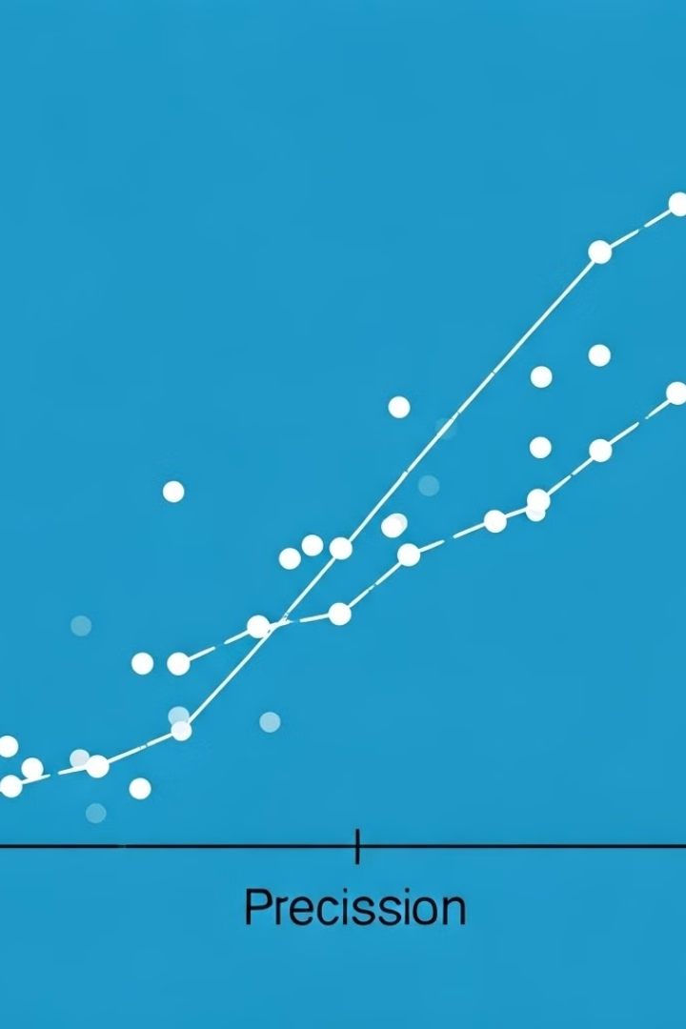
Dataset
Source
Kaggle (modified Stanford Cars Dataset)
Type
Uncropped car images
Classes
30
Training Images
6,496
Testing Images
958
Data Split
70% train, 20% validation, 10% test

Slide 4
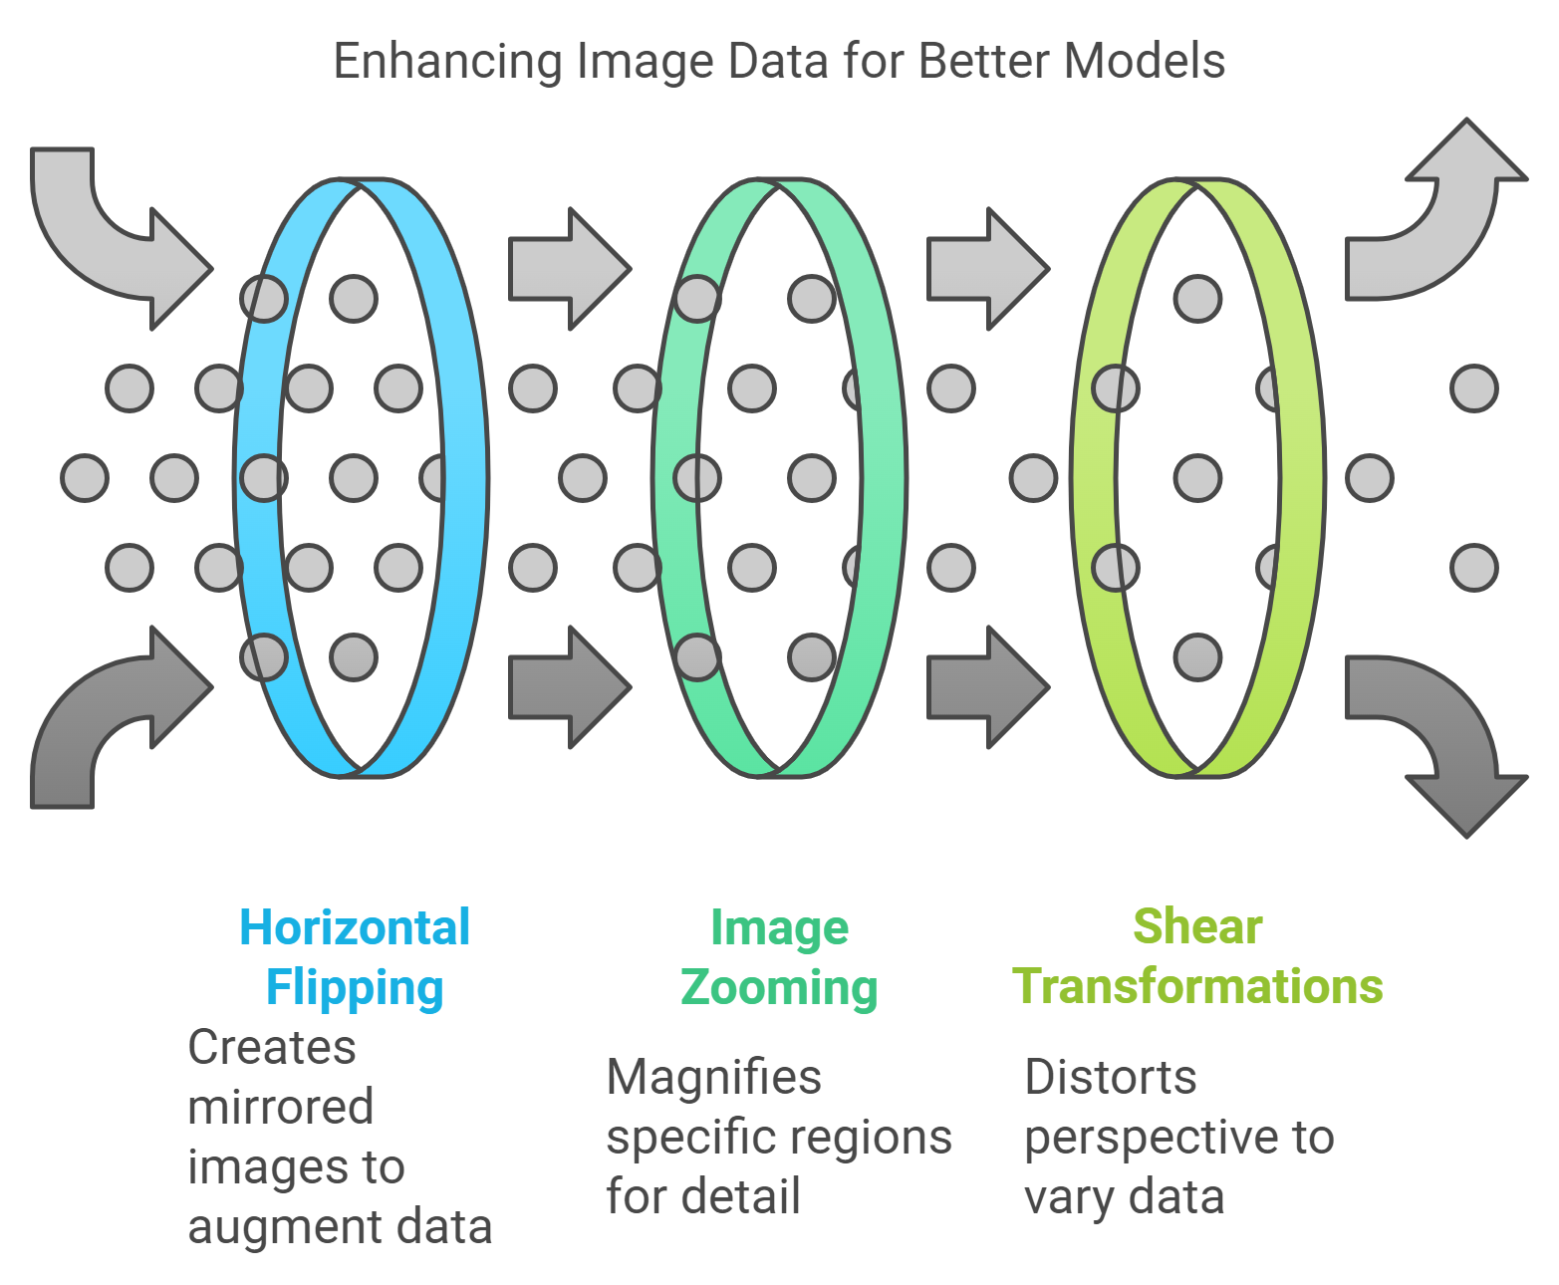

Slide 5






Model Architecture
Conv2D
Extracts image features.
MaxPooling2D
Reduces dimensionality.
Dropout
Prevents overfitting.
Flatten
Converts matrix to a vector.
Dense
Classifies into 30 car classes.

Slide 6

Training Configuration
1
Data Preparation
ImageDataGenerator is used for data augmentation and preprocessing. This enhances model generalization and robustness.
2
Model Compilation
The model is compiled using TensorFlow Keras. Appropriate loss function and optimizer are selected.
3
Training Optimization
EarlyStopping prevents overfitting by halting training when validation performance plateaus. ReduceLROnPlateau dynamically adjusts learning rate.

Slide 7
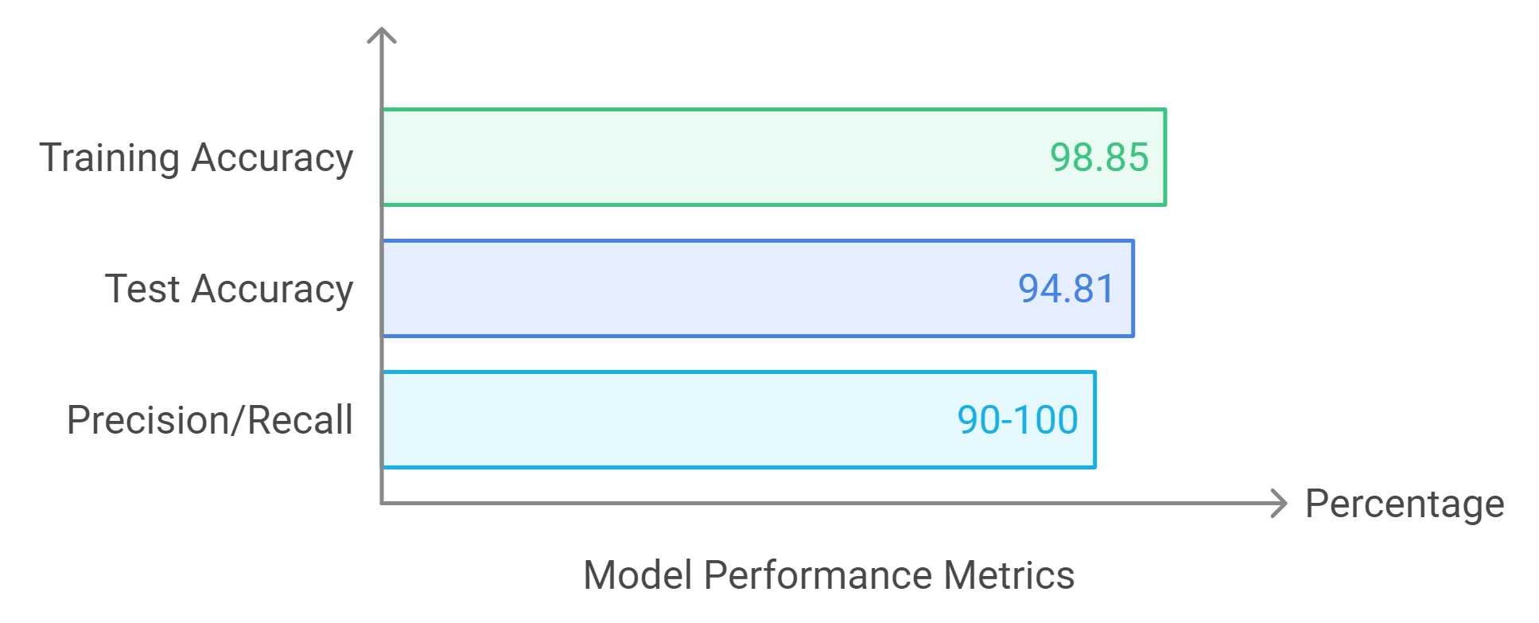

Slide 8
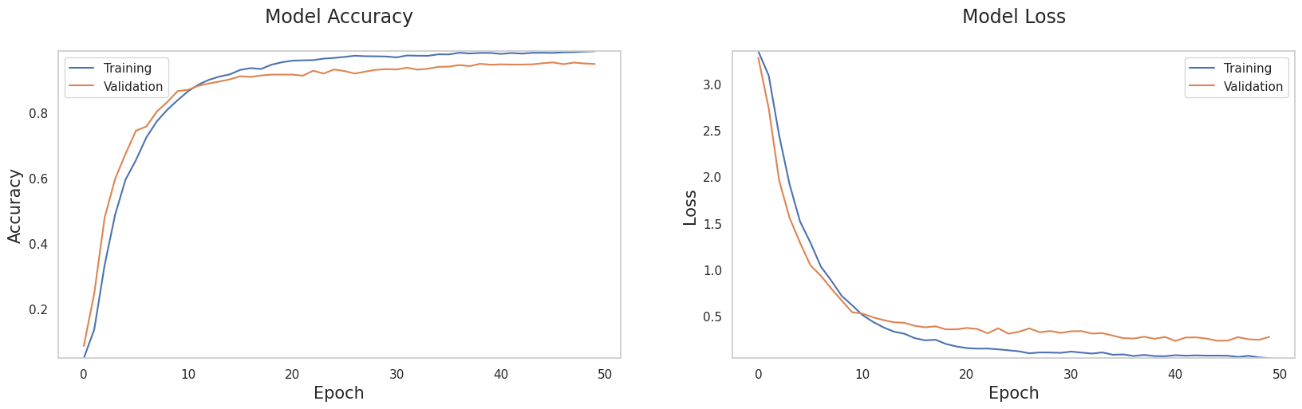
Visual Results
Accuracy Progression
Visualizes accuracy improvement.
Loss Reduction
Shows decreasing loss over epochs.

Slide 9

Conclusions

Slide 10

Questions
Open for questions and discussions.

